Slide 1

Making the publication treadmill more fun by using R - accessible spreadsheets with the openxlsx package
Maike Waldmann (she/her)
R User Day 2021

Slide 2
Overview
the basics: create spreadsheet
customise: make it look nice and more accessible
automate: some ideas

Slide 3
MY usual Project setup
myproject
R
data
output
Project folder, has .Rproj file and subfolders – tidy!
R scripts
data = your input data (sas7bdat, xls, csv, rds, ...)
output = your outputs (xls, ods, png, svg, html, …)
data
.R
.R .R
.R
output

Slide 4
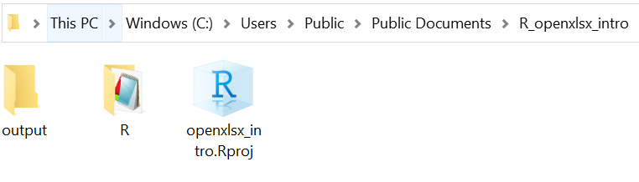
Today’s setup

Slide 5
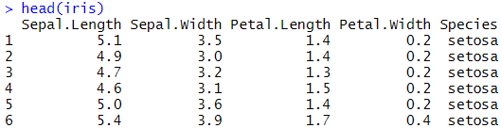
iris dataset
library(tidyverse)
head(iris)

Slide 6
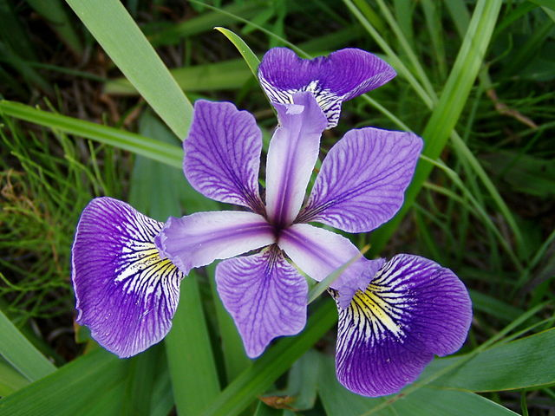
IRIS
Irises have 3 petals and 3 sepals.
Sepals are the longer ones.
Iris versicolor from Iris flower data set - Wikipedia

Slide 7
data wrangling
table <- iris %>%
group_by(Species) %>%
summarise(Sample = n(),
Petal_length_mean = mean(Petal.Length),
Sepal_length_mean = mean(Sepal.Length)) %>%
mutate(Ratio_S_P = Sepal_length_mean/Petal_length_mean,
Ratio_S_P = round(Ratio_S_P, 2),
Petal_length_mean = round(Petal_length_mean, 1),
Sepal_length_mean = round(Sepal_length_mean, 1) )

Slide 8
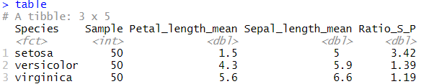
R output

Slide 9
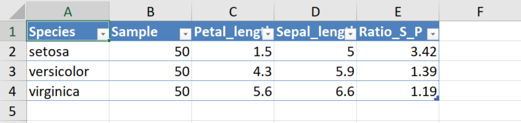
create spreadsheet – qUick way
library(openxlsx)
write.xlsx(table, "output/iris_table_quick.xlsx", asTable = TRUE)

Slide 10
create spreadsheet – LONG way
wb <- createWorkbook()
addWorksheet(wb, "Iris_table")
writeData(wb, "Iris_table",
"Mean petal and sepal lengths by iris species")
writeDataTable(wb, "Iris_table", table, startRow = 2)
# writeData(wb, "Iris_table", table, startRow = 2) works too, but inaccessible
saveWorkbook(wb, 'output/iris_table_long.xlsx', overwrite = TRUE)

Slide 11
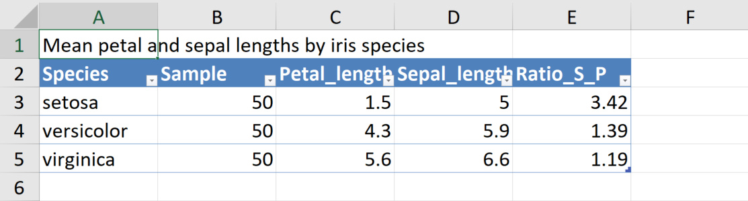
LONG way

Slide 12
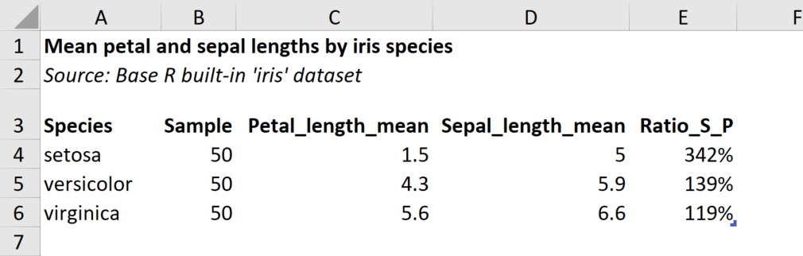
Make table look nice

Slide 13
Customise
# no gridlines
addWorksheet(…, gridLines = FALSE)
# format: bold, italic, right-aligned, percent-format, …
addStyle(…, createStyle(textDecoration = "bold“, numFmt = "0%“, halign = “right))
# simplify table style
writeDataTable(…, tableStyle = "none", withFilter = FALSE)
# adjust column widths
setColWidths(…, cols = 2:ncol(table), widths = "auto")
# adjust row height
setRowHeights(…, rows = 3, heights = 25)

Slide 14
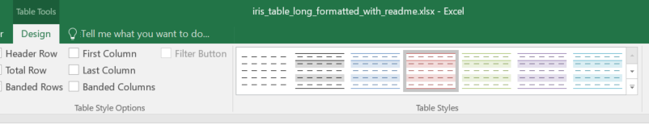
Table styles
To find Excel style names: click on your table -> Design -> Table Styles (hover over each to get name (“Table Style Light 3”), remove spaces:
writeDataTable(…, tableStyle = “TableStyleLight3“, …)

Slide 15
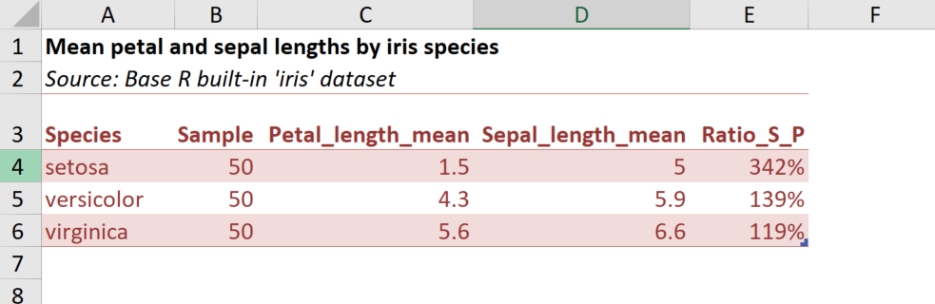
Table Style Light 3

Slide 16
Add more worksheets
wb <- createWorkbook()
addWorksheet(wb, "Readme")
addWorksheet(wb, "Contents")
addWorksheet(wb, "Notes")
addWorksheet(wb, "Iris_table")
saveWorkbook(wb, 'output/iris_table_long.xlsx', overwrite = TRUE)

Slide 17
Add just text
wb <- createWorkbook()
…
addWorksheet(wb, "Readme")
writeData(wb, "Readme",
c("Readme",
"This document contains a simple example of an accessible table.",
"There isn't a lot more to say",
"Add as many lines as you want."))
addStyle(wb, "Readme", rows = 1, cols = 1,
createStyle(textDecoration = "bold"))
…
saveWorkbook(wb, 'output/iris_table_long.xlsx', overwrite = TRUE)

Slide 18
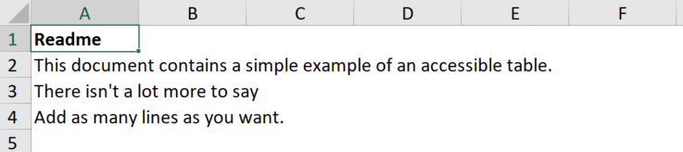
READme sheet
Readme worksheet

Slide 19
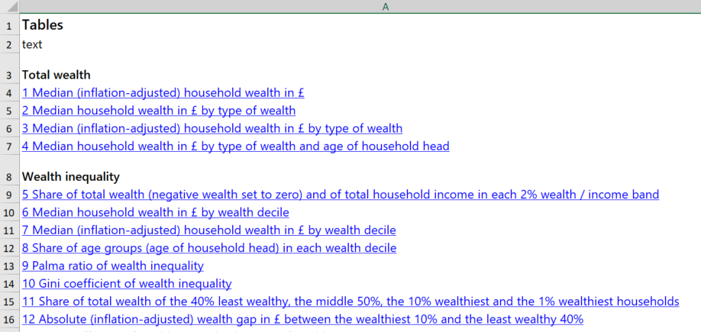
Auto TOC example

Slide 20
You can also…
add multiple tables to a worksheet (but more difficult to make them accessible)
add borders and colours (but watch out for contrast, and make sure text colour is set to auto)
automate more, if you have many similar tables: use functions to loop through all tables in a list that should go into a worksheet
include hyperlinks
My code tends to end up verbose when using openxlsx.

Slide 21
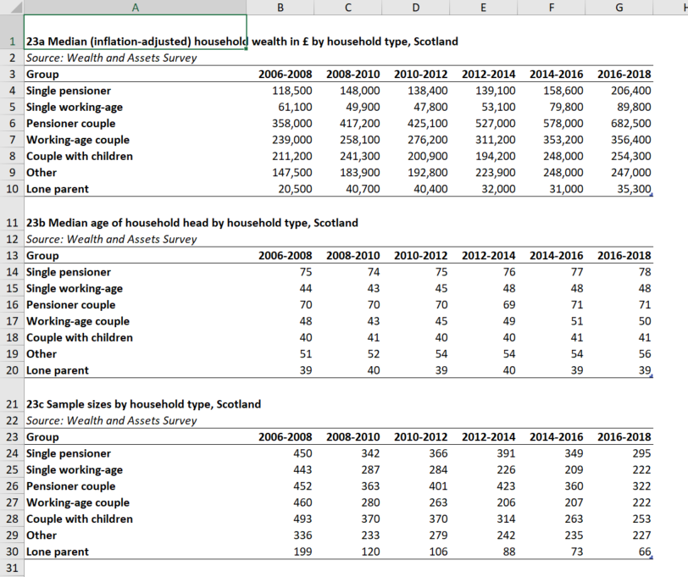
Multiple tables example
Table a) Median wealth by hhld type
Additional tables for context:
Table b) Median age
Table c) Sample sizes

Slide 22
BONUS: ODS
An R script that uses VBA to create ods versions of all compatible xlsx files in your data folder. (what’s compatible: Differences between the OpenDocument Spreadsheet (.ods) format and the Excel for Windows (.xlsx) format (microsoft.com))
You need 3 files:
‘xlsx_to_ods.R’ in your R folder
‘Run Excel Macro.vbs’ in your project folder
‘VBA – Convert XLSX to ODS.xlsm’ in your project folder
Make your project folder a “Trusted location” for Office: Add, remove, or change a trusted location (microsoft.com)
With thanks to Neil Perkins (PHS) and Andrew Waugh (SG)

Slide 23
xlsx_to_ods.R
system_command <- paste("WScript", '"Run Excel Macro.vbs"', sep = " ")
system(command = system_command, wait = TRUE)
print("ods. files have been saved to /output")

Slide 24
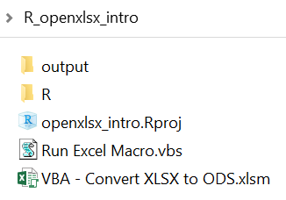
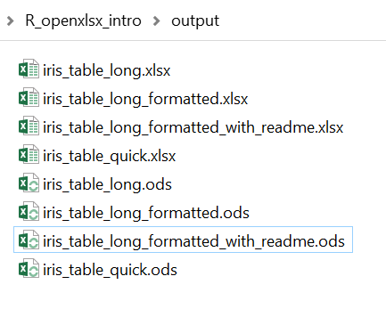
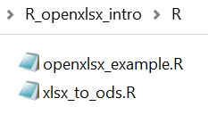
NEW setup

Slide 25

Resources
All files used in this presentation:
github.com/DataScienceScotland/openxlsx_intro
Accessible spreadsheets guidance: Releasing statistics in spreadsheets – GSS (civilservice.gov.uk) (also has excellent Youtube tutorial)

